Slide 1


Project Title -AIRBNB Hotel Booking Analysis
NAME :TUSHAR KAPOOR

Slide 2

PROBLEM STATEMENT
Netflix has become one of the most prominent global streaming platforms, continuously expanding its library with a mix of original productions and licensed content. However, with growing competition from platforms like Amazon Prime, Disney+, and regional OTT providers, Netflix must strategically analyze its content catalog to identify strengths, gaps, and opportunities.
The specific problem to be addressed in this project is 'Content Trends Analysis for Strategic Recommendations'. The aim is to uncover how Netflix’s content distribution (Movies vs. TV Shows, genres, and country contributions) has evolved over the years. This will enable the identification of key genres, audience preferences, and strategic insights into global content expansion.

Slide 3
Project Description This project involves an in-depth analysis of Netflix’s content library using data analytics and machine learning techniques. The dataset contains over 7,700 records of Movies and TV Shows, including details like title, director, cast, country, release year, rating, duration, and genres. The goal is to explore content trends, identify popular genres and countries, detect outliers, and use machine learning models to predict whether a title is a Movie or TV Show based on key attributes. Key Focus Areas: Comparative analysis between Movies and TV Shows over time. Identification of most popular genres and regions contributing to Netflix’s catalog. Handling missing values and outliers for clean, reliable insights. Building predictive models (Logistic Regression & Random Forest) to classify content type. Providing strategic recommendations to enhance Netflix’s content acquisition strategy. Highlights: Visualized content distribution using interactive charts (Plotly & Seaborn). Discovered evolving trends and patterns across years, genres, and countries. Applied data preprocessing, feature engineering, and ML-based prediction for actionable insights.

Slide 4

WHO ARE THE END USERS?
1. Netflix Content Strategy Team: To make data-driven decisions for content acquisition, genre focus, and international expansion.
2. Data Analysts & Data Scientists: For conducting exploratory data analysis (EDA), model building, and identifying key performance patterns.
3. Marketing & Recommendation Teams: To tailor regional marketing strategies and improve personalized content recommendations.
4. Media Research & Academic Institutions: For studying OTT content evolution, media consumption patterns, and global entertainment trends.

Slide 5

Technology Used
Python 3.x for data analysis scripting
Jupyter Notebook for interactive exploration and reporting
pandas for data loading, cleaning, transformation, and summaries
NumPy for numerical operations and arrays
seaborn and Matplotlib for statistical visualizations (histograms, KDE, boxplots, heatmaps, scatter)
SciPy (trim_mean, Spearman/Pearson correlation, IQR utilities) for basic statistics
Plotly Express (optional) for interactive charts
datetime/pandas to_datetime for parsing and using date fields
Git/GitHub (optional) for version control and collaboration
Category | Tools / Technologies | Purpose
Programming Language | Python | Data analysis, visualization, and machine learning
Data Manipulation | Pandas, NumPy | Data cleaning, wrangling, and feature preparation
Visualization | Matplotlib, Seaborn, Plotly | Graphical exploration, trend analysis, and interactive dashboards
Machine Learning | Scikit-learn | Model building (Logistic Regression, Random Forest), evaluation, and feature importance
Statistical Analysis | SciPy | Outlier detection and correlation study
IDE / Environment | Jupyter Notebook | Development, analysis documentation, and visualization
Dataset Source | Netflix Titles Dataset (2008–2021) | Real-world content metadata used for analysis

Slide 6
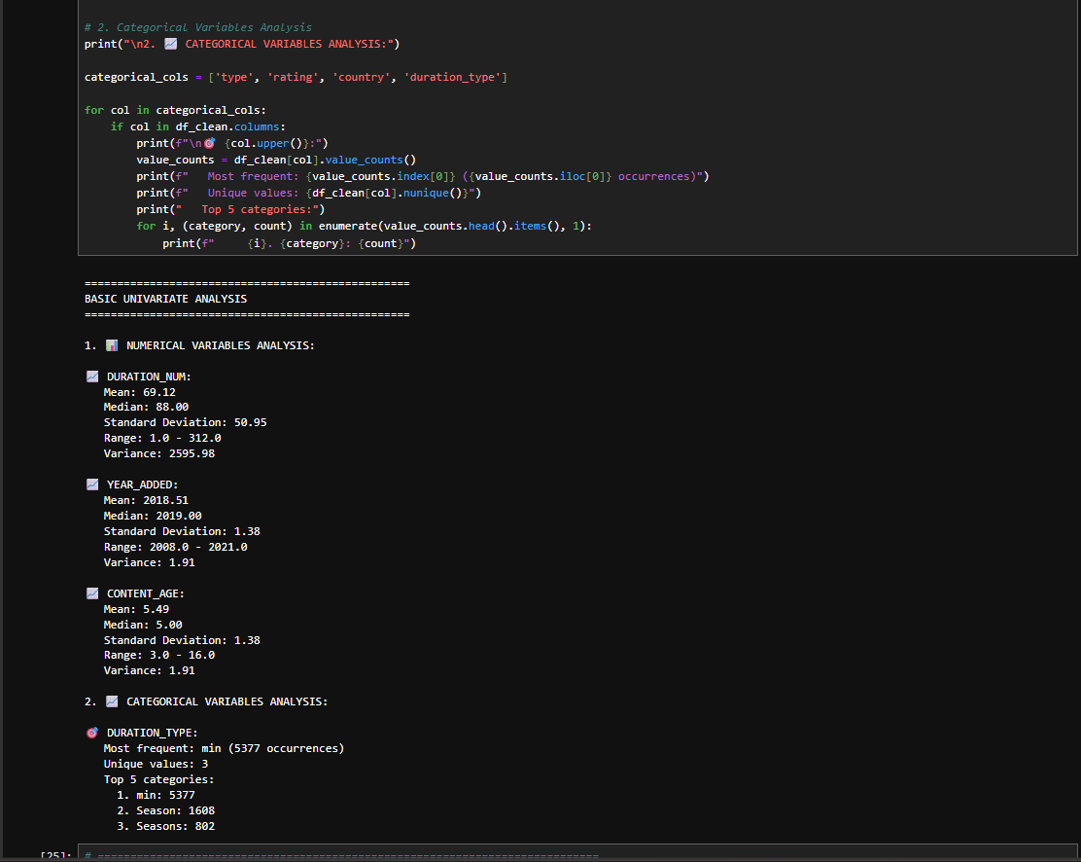
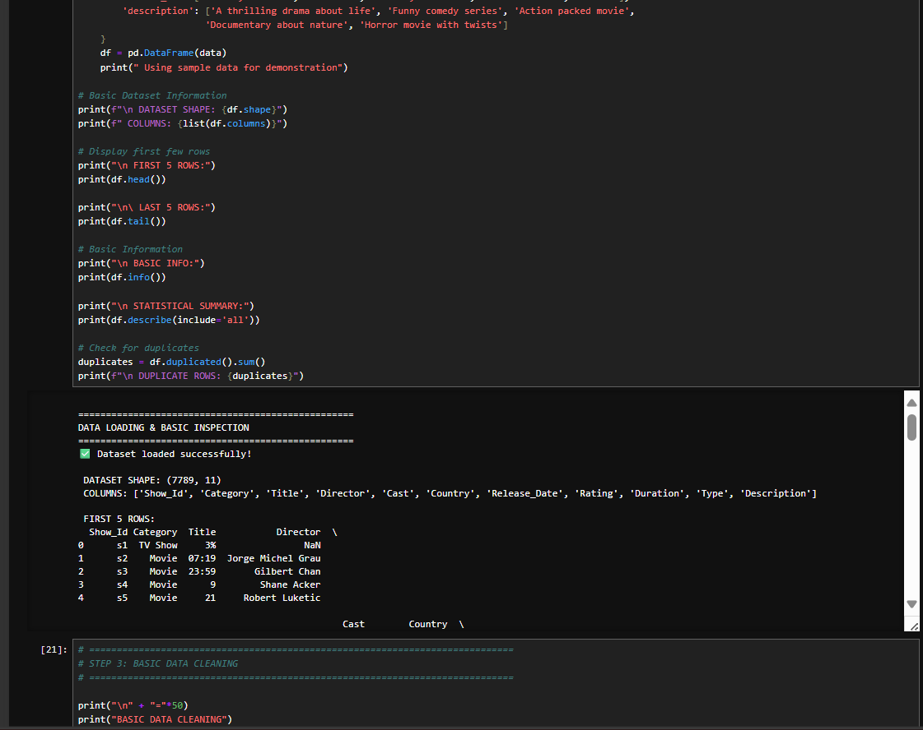
RESULTS1
Demo Link

Slide 7
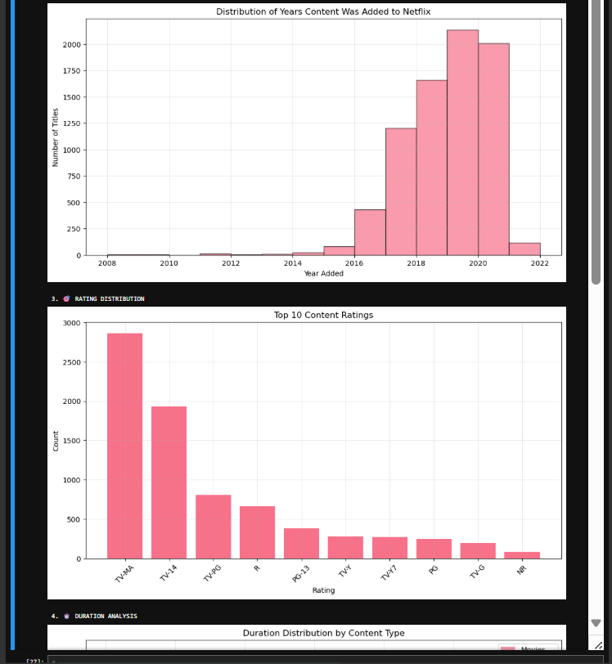
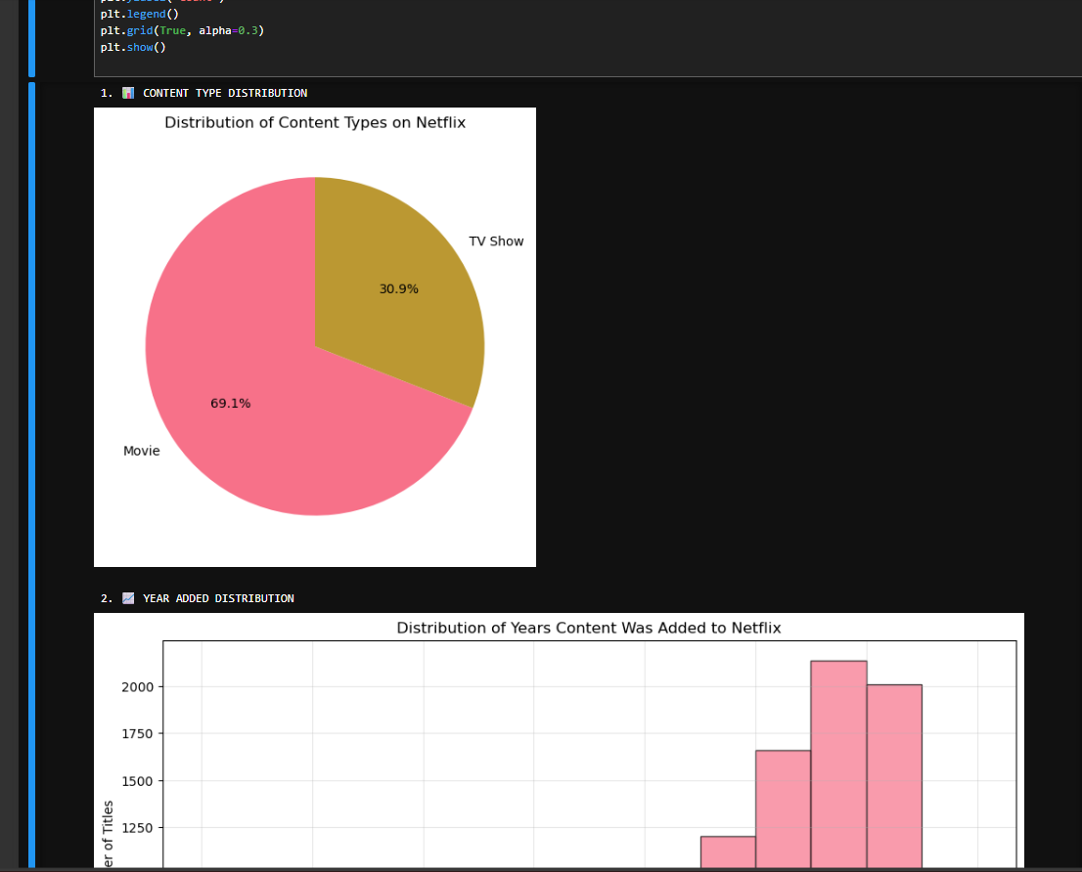
RESULTS2
[Add screen shots of your code or Chart(s) ]
Demo Link

Slide 8
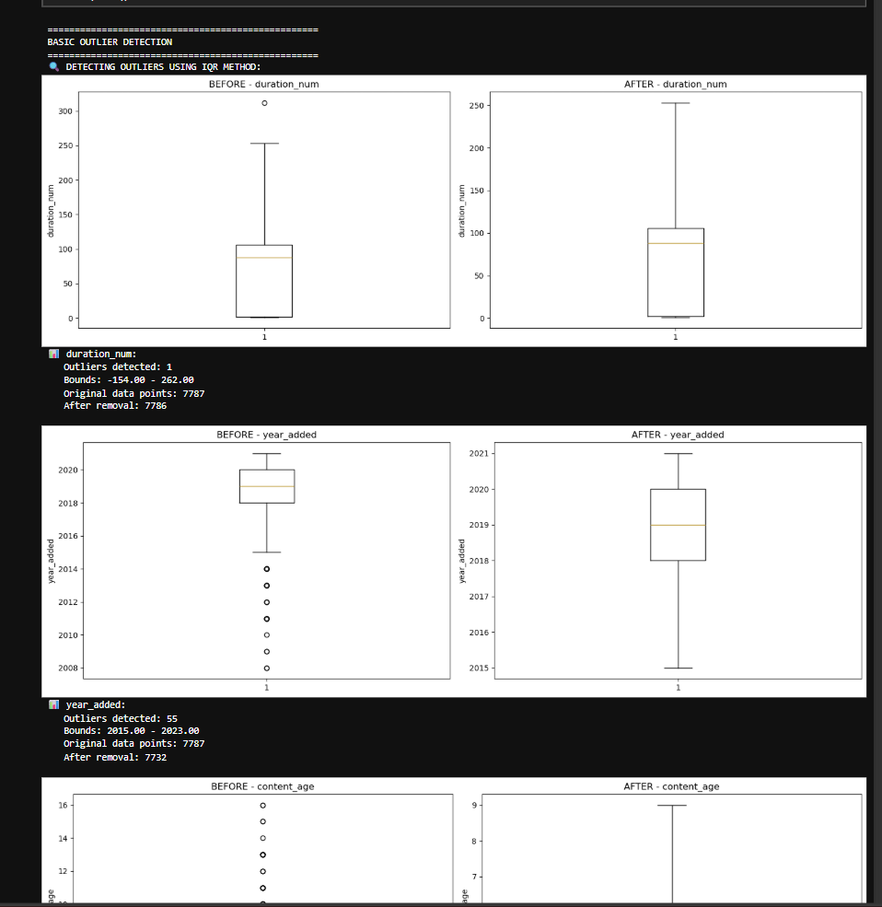
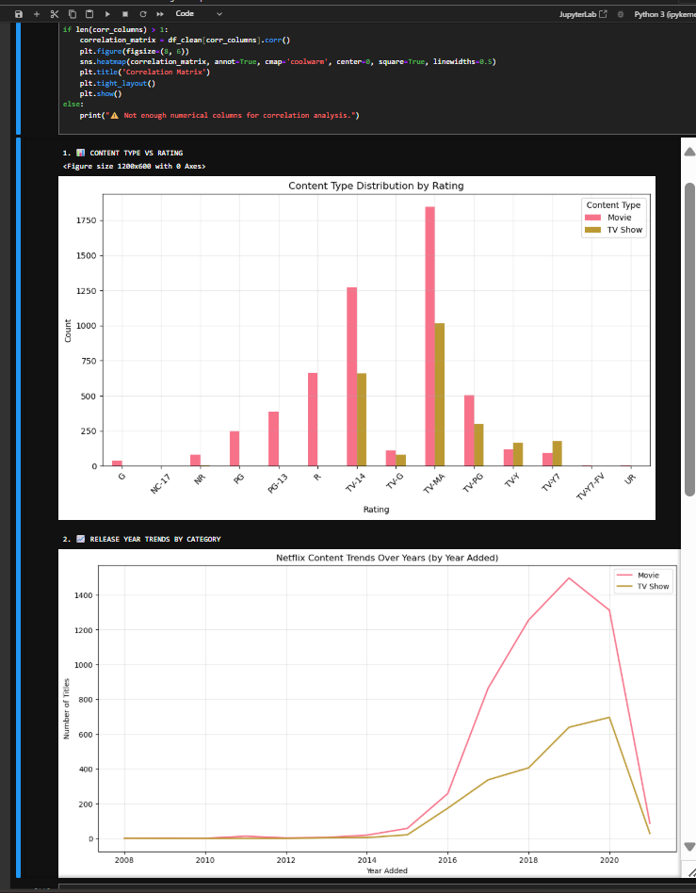
RESULTS3
[Add screen shots of your code or Chart(s) ]
Demo Link

Slide 9
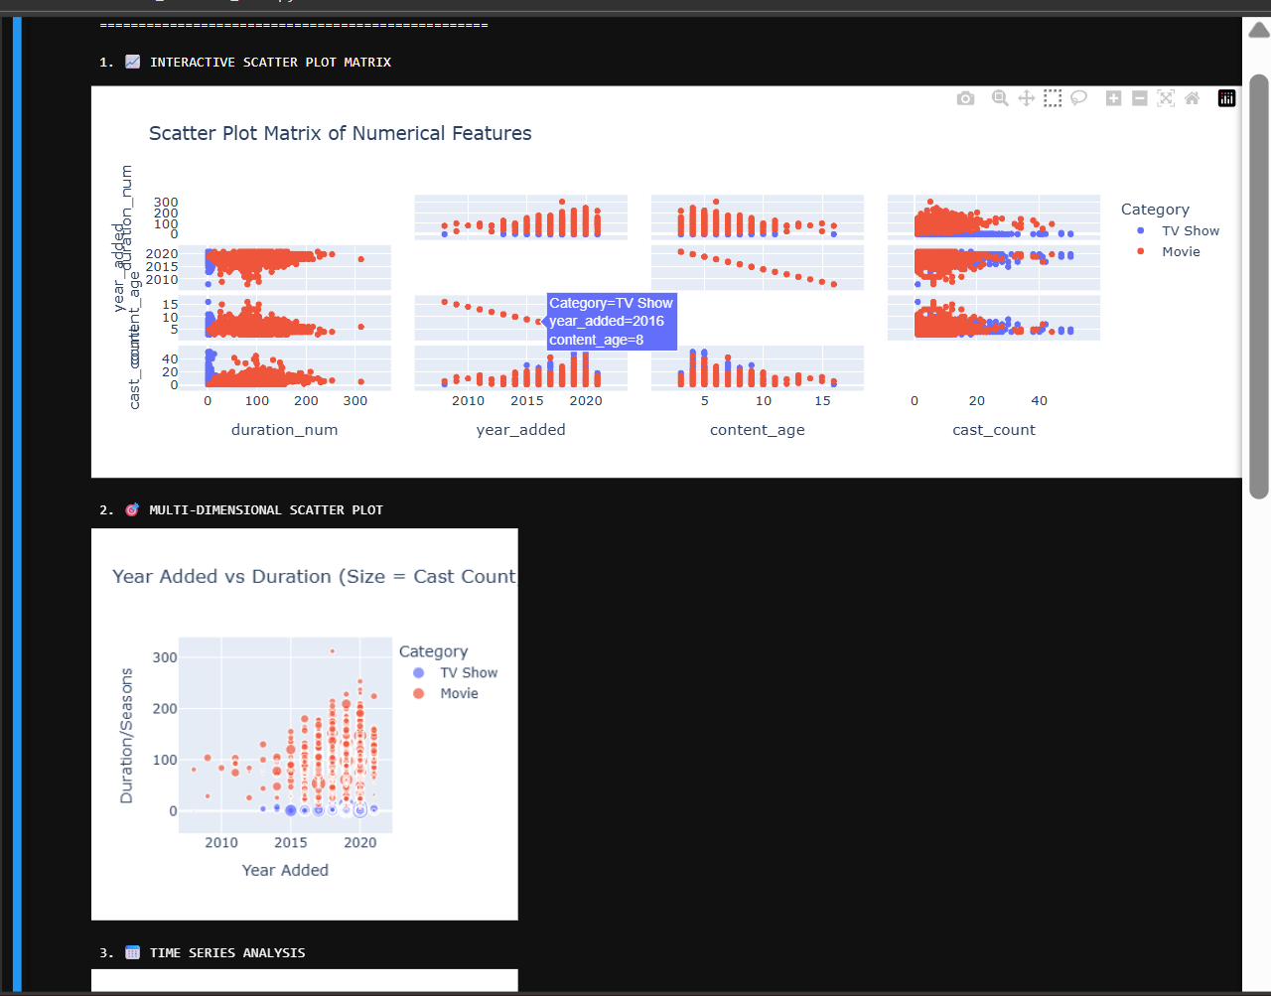
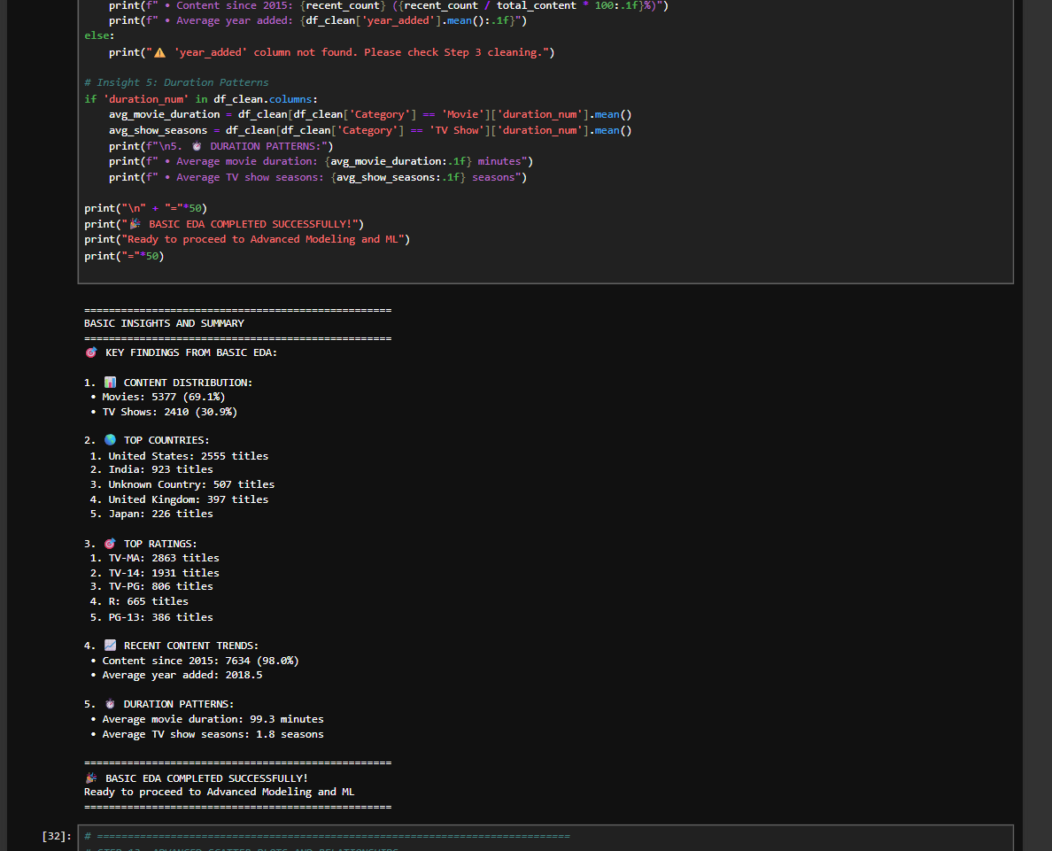
RESULTS4
[Add screen shots of your code or Chart(s) ]
Demo Link

Slide 10
GitHub repository
https://github.com/Tusharkapoor-oop/VOIS_AICTE_Oct2025_TUSHAR-KAPOOR
Demo Link

Slide 11
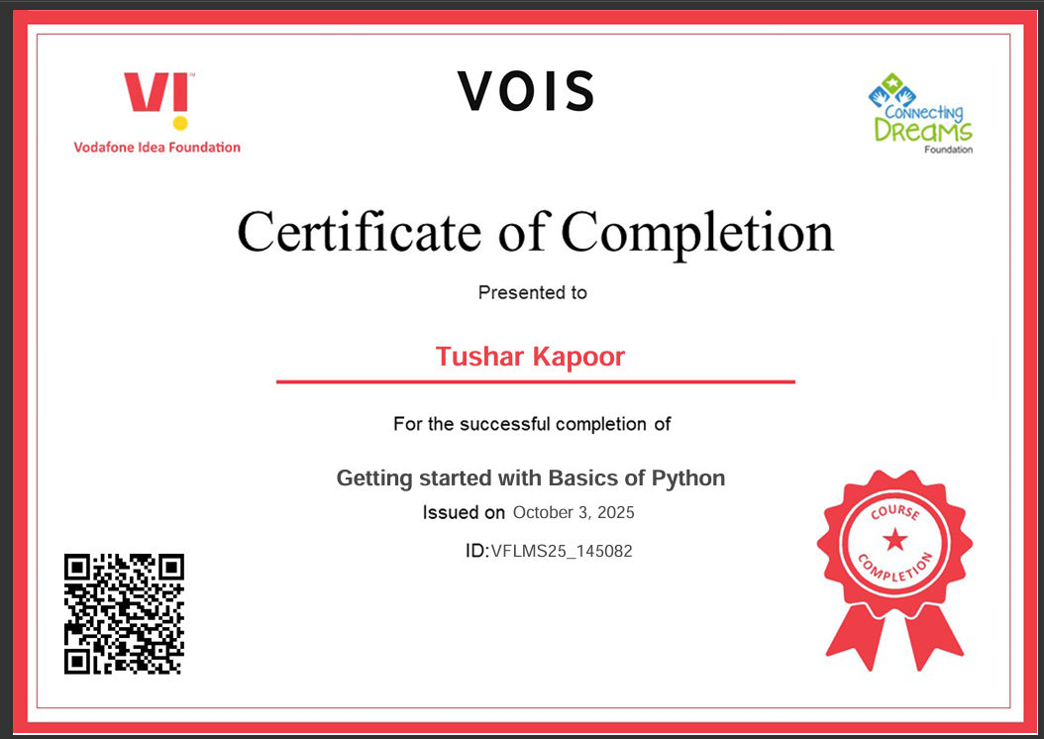
Getting started with Basics of Python Certificate

Slide 12
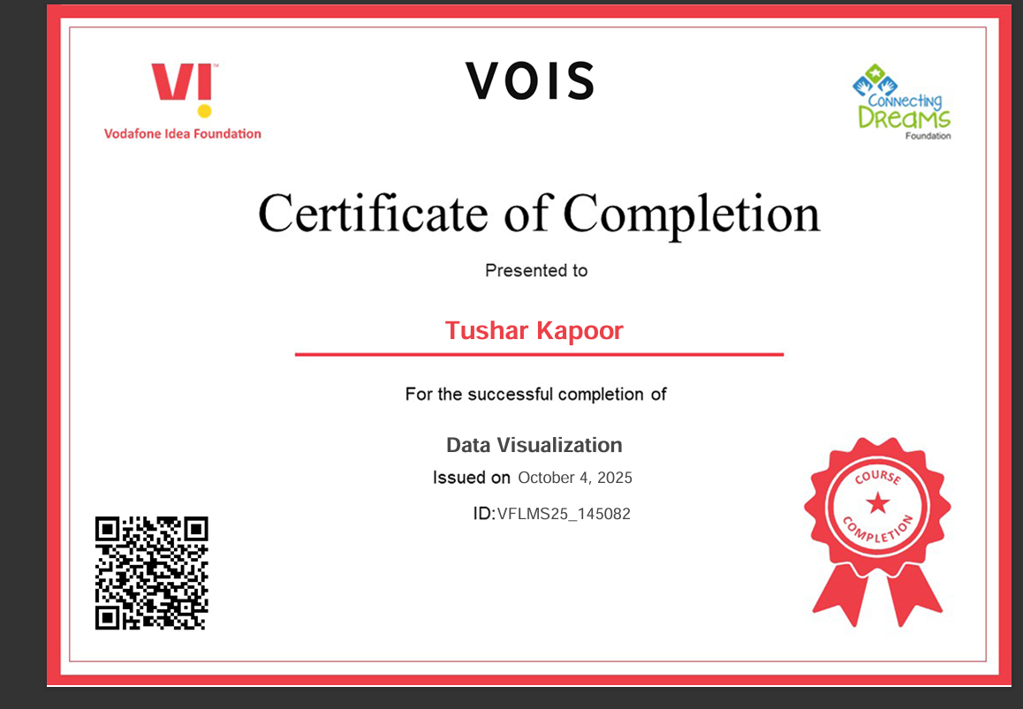
Data Visualization Certificate

Slide 13
Thank you
.
.

